Slide 1
CISSP Bootcamp: VOLUME TWO
Certified Information Systems Security Professional
Kelly Handerhan, Instructor, Owner, CyberTrain.it
CISSP, CCSP, CISM, CRISC, PMP, Security+, etc.
KellyH@CyberTrain.IT

Slide 2
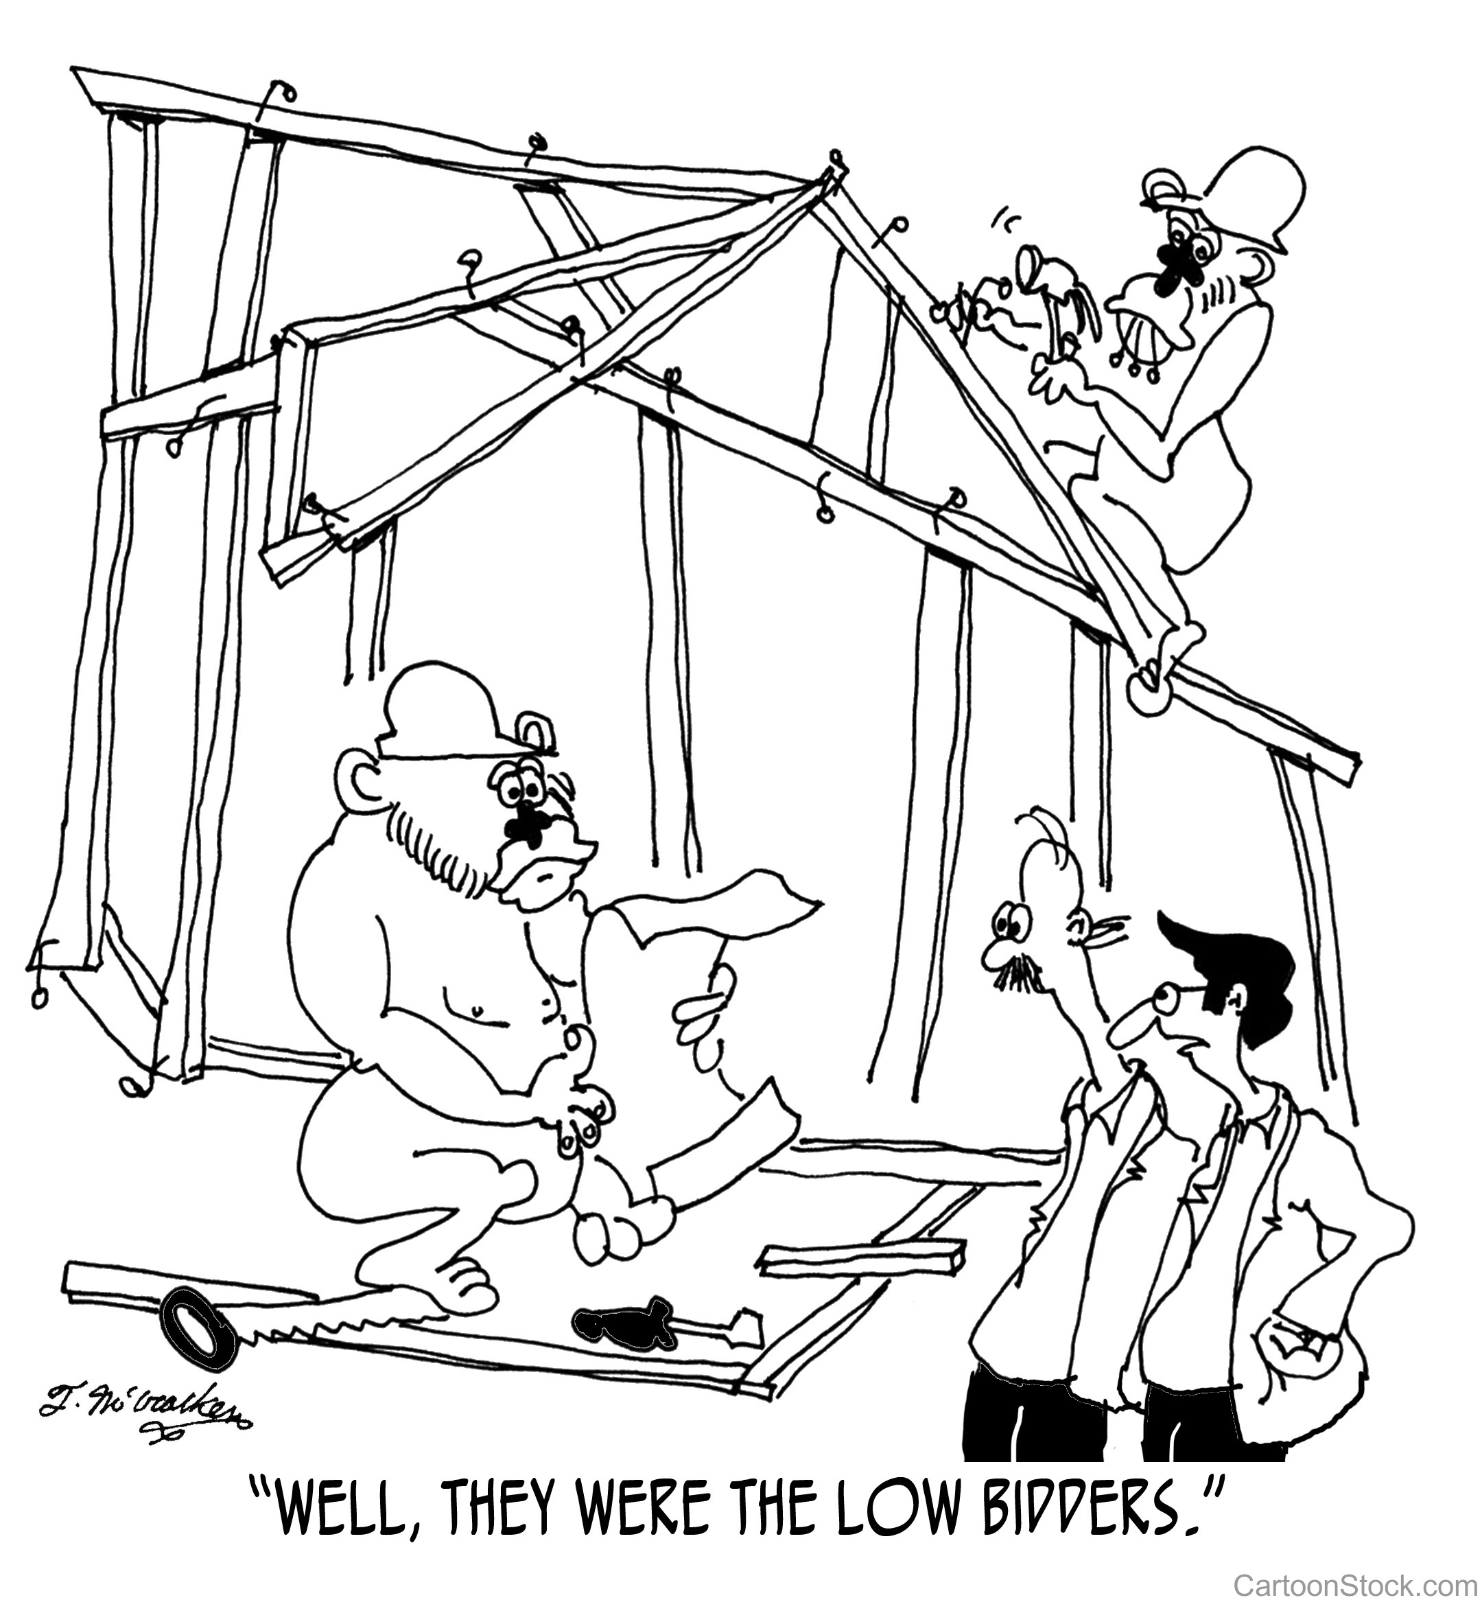
Domain 3 Security Architecture and Engineering
Part 2 : Security Architecture and Design

Slide 3
Domain 3 Part 2: Security Architecture and Design Agenda
Security Models
System Architecture
The Trusted Computing Base
Hardware Architecture
Software: Operating System Architecture
Software: Application Architecture
Secure Modes of Operation
Certification and Accreditation

Slide 4
Security Models

Slide 5
Security Models and Architecture
A security model Provides the means to formalize a system policy into an explicit set of rules that a computer can follow to implement the fundamental security concepts, processes, and procedures that make up a security policy
The system architecture, in turn, is the overall design and description of the interaction of (HW, SW, Applications, etc.) of an information system.
This architecture should enforce the specifications provided by the security model.

Slide 6
Security Models
State Machine Model
**The Bell-LaPadula Model
**The Biba Model
The Clark-Wilson Model
The Brewer & Nash Model
The Information Flow Model
The Non-Interference Model
The Lattice Model

Slide 7
State Machine Model
The state of a system is its snapshot at any one particular moment. The state machine model describes subjects, objects, and sequences in a system. The focus of this model is to capture the system’s state and ensure its security.
When an object accepts input, the value of the state variable is modified. For a subject to access this object or modify the object value, the subject should have appropriate access rights.
State transitions refer to activities that alter a systems state.

Slide 8
Bell-LaPadula Model
Confidentiality model
Developed by David Elliot Bell and Len LaPadula
This model focuses on data confidentiality and access to classified information.
A Formal Model developed for the DoD multilevel security policy
This formal model divides entities in an information system into subjects and objects.
Model is built on the concept of a state machine with different allowable states (i.e. Secure state)

Slide 9
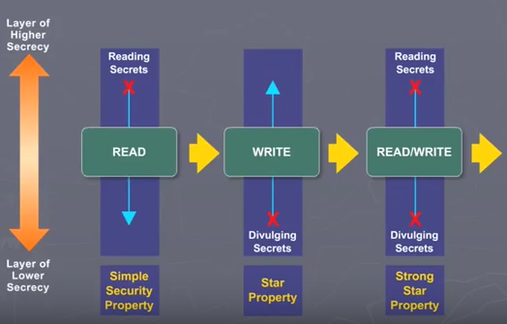
Bell Lapadula
Three Rules to enforce confidentiality:
Simple Security Property – “no read up”
A subject cannot read data from a security level higher than subject’s security level.
*_Security Property – “no write down”
A subject cannot write data to a security level lower than the subject’s security level.
Strong * Property – “no read/write up or down”.
A subject with read/write privilege can perform read/write functions only at the subject’s security levels.

Slide 10
Biba Integrity Model
Developed by Kenneth J. Biba in 1977 based on a set of access control rules designed to ensure data integrity
No subject can depend on an object of lesser integrity
Based on a hierarchical lattice of integrity levels
Authorized users must perform correct and safe procedures to protect data integrity

Slide 11

Biba Integrity Model
Three Rules:
Simple integrity axiom – “no read down” – A Subject cannot read data from an object of lower integrity level.
* Integrity axiom – “no write up” – A Subject cannot write data to an object at a higher integrity level.
Invocation property – A subject cannot invoke (call upon) subjects at a higher integrity level.
Simple Integrity Axiom
*_Integrity Axiom
Invocation Property

Slide 12
Clark-Wilson
Integrity model
Model Characteristics:
Clark Wilson enforces well-formed transactions through the use of the access triple:
User➔Transformation Procedure➔CDI (Constrained Data Item)
Deals with all three integrity goals
SEPARATION of DUTIES
Prevents unauthorized users from making modifications
Prevents authorized users from making improper modifications
Maintain internal and external consistency – reinforces separation of duties

Slide 13
Commercial Models: Brewer-Nash
Brewer-Nash Model – a.k.a. Chinese Wall
Developed to combat conflict of interest in databases housing competitor information
Publish in 1989 to ensure fair competition
Defines a wall and a set of rules to ensure that no subject accesses objects on the other side of the wall
Way of separating competitors data within the same integrated database

Slide 14
Information Flow Model
Data is compartmentalized based on classification and the need to know
Model seeks to eliminate covert channels
Model ensures that information always flows from a low security level to a higher security level and from a high integrity level to a low integrity level.
Whatever component directly affects the flow of information must dominate all components involved with the flow of information

Slide 15
Non-interference Model
Model Characteristics:
Model ensures that actions at a higher security level does not interfere with the actions at a lower security level.
The goal of this model is to protect the state of an entity at the lower security level by actions at the higher security level so that data does not pass through covert or timing channels.

Slide 16
Lattice Model
Model consists of a set of objects constrained between the least upper bound and the greatest lower bound values.
The least upper bound is the value that defines the least level of object access rights granted to a subject.
The greatest lower bound is value that defines the maximum level of object access rights granted to a subject
The goal of this model is to protect the confidentiality of an object and only allow access by an authorized subject.

Slide 17
System Architecture

Slide 18
Security Architecture Overview
Security architecture directs how the components included in the system architecture should be organized and interact to ensure that security requirements are met.
A description of the locations in the overall architecture where security measures should be placed.
A description of how various components of the architecture should interact to ensure security.
The security specifications to be followed when designing and developing the system.

Slide 19
The Trusted Computing Base

Slide 20
The Trusted Computing Base
Trusted Computing Base: The trusted computing base (TCB) consists of all hardware, software, and firmware within a system that provide enforces the security of a system and provides a description of the trust of a system.
Security Perimeter: Conceptual separation between the TCB and the untrusted elements of a system
TCB components include the CPU, RAM, the OS Kernel, BIOS, etc.
The TCB is what is evaluated when certifying a system

Slide 21
Hardware Architecture

Slide 22
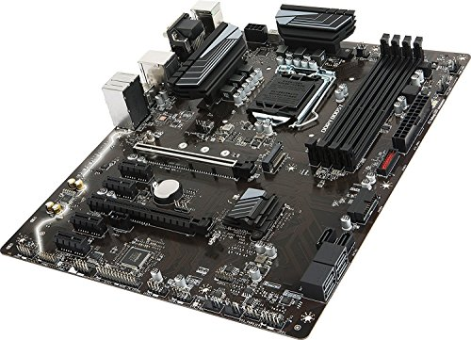
Hardware Architecture
Central Processing Unit (CPU)
Registers
ALU
Math Co-processor
Memory
ROM
RAM
SRAM
Cache L1, L2, etc
DRAM
Flash
Virtual Memory
Input/Output (I/O)
System Bus & Channels
System Bus
Data Bus
Control Bus
Storage
Magnetic
Optical
Solid State
Notes:
A system bus is a single computer bus that connects the major components of a computer system
Data bus carries information
An Address Bus determines where in memory the data should be sent,
Control bus to determine its operation

Slide 23
CPU Protection Mode
The unrestricted mode is often called kernel mode (aka supervisor mode, privileged mode, etc.).
the CPU may perform any operation, access any location in RAM, perform I/O operations, without restrictions
Restricted mode is usually referred to as user mode or problem state. In this mode, the CPU is prevented (by other elements of the architecture) from performing any activity that may impact the security of a system

Slide 24
Memory
Memory
ROM (Read Only Memory)
RAM (Random Access Memory)
SRAM (Static RAM)
Cache L1, L2, etc
DRAM (Dynamic RAM)
Flash
Virtual Memory (Swap or paging file located on permanent storage

Slide 25
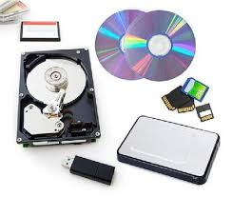
Storage
Temporary
RAM
Permanent
Magnetic
Optical
Solid State

Slide 26
System Buses
There are generally two buses within a computer. The first is the internal bus (sometimes called the front-side bus, or FSB for short). The internal bus allows the processor to communicate with the system's central memory (the RAM).
The second is the expansion bus (sometimes called the input/output bus), which allows motherboard components (i.e. USB, serial, sound, NIC], cards inserted in expansion slots, hard drives, CD-ROM and CD-RW drives, etc.) to communicate with one another.

Slide 27
Software: Operating System Architecture

Slide 28
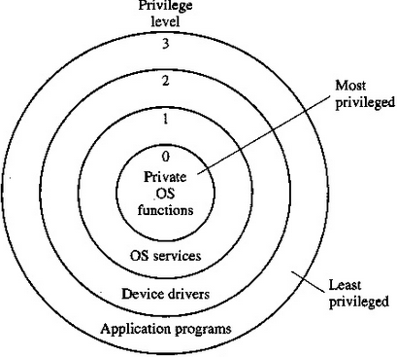
CPU Modes & Protection rings
Protection Rings isolate layers of trust to ensure that competing processes do not affect each other or harm critical system components.
Ring 0 – Operating system kernel (supervisor /privilege mode)
Ring 1 – Remaining parts of the operating system (OS)
Ring 2 – Operating system and I/O drivers and OS utilities
Ring 3 – Applications (Programs) and user activity

Slide 29
Operating System Kernel
The reference monitor concept deﬁnes the set of design requirements to make the determination regarding subject/object access. It provides the rules that govern access. Think: The law
The security kernel are the actual components which enforce the rules of the reference monitor. Think: The police
Three requirements for the reference monitor/security kernel
Must facilitate isolation of processes
Must be invoked at every access attempt.
Must be small enough to be tested and verified in a comprehensive manner.
Security Policy – a set of rules on how resources are managed within a computer system.

Slide 30
Programs, Processes, Threads
Program: An Application
Process: A program loaded into memory
Thread: Each individual instruction within a process
Multi-programming: Multiple programs “open” but no true isolation
Multi-tasking: Isolation of processes—more than a single Process can run at one time
Multi-processing – more than one CPU
Multi-threading—in the past multiple CPUs were needed.
Multi-core processors provide hardware multithreading

Slide 31
Software: Application Architecture

Slide 32
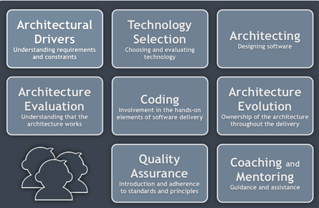
Software Architecture

Slide 33
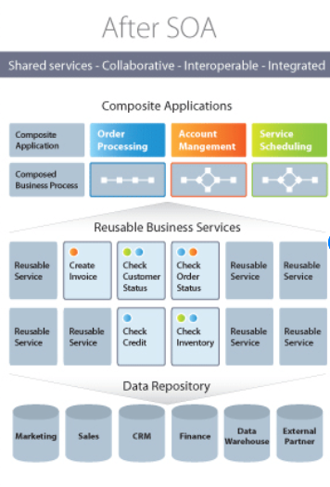
Web Services
Web Services allow different applications to communicate with each other regardless of platform, programming language or operating system
Web Services rely on standards-based APIs and Service Oriented Architecture

Slide 34
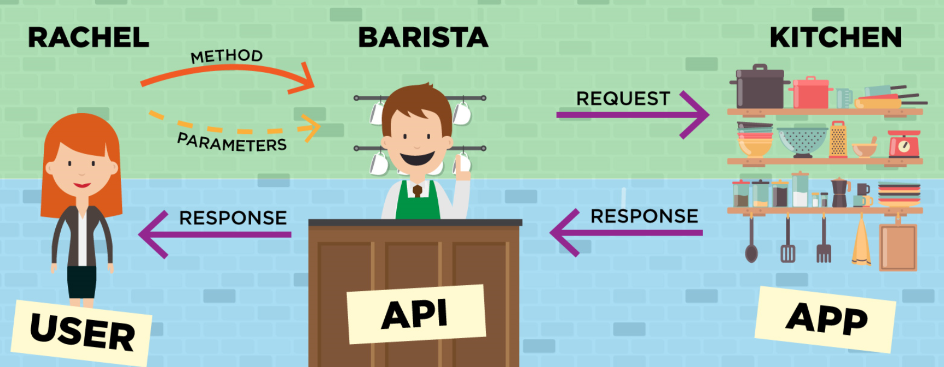
APIs
Programing code that governs how a web service can request information or services. APIs define 3 primary elements:
Access: who is allowed to ask for data or services.
Request: what data or services can be asked for (e.g., if I give you an address can you tell me how to get there?). Requests have two main parts:
Methods: the type of questions you can ask, assuming you have access (it also defines the type of responses available).
Parameters: additional details you can include in the question or response.
Response: the data or service for your request.
The map we left her and the fact that the coffee shop was open gave her access to the API.
When she got to the coffee shop, she had access to the menu with all the different options. She knew what you can ask for (methods) and the options and details (parameters). This told her how to place her request for food. Once Rachel placed her request, the barista played the role of the API and sent a message to the kitchen.
Rachel then just had to wait for the response in the form of food and beverage, which the barista, acting as the API, delivered to her with a smile (nice folks at The Grind).

Slide 35
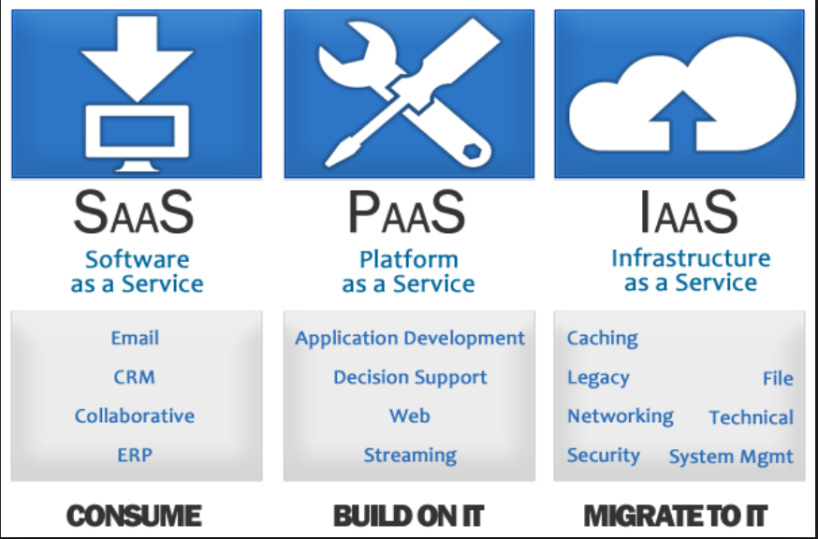
Cloud Architecture
https://www.pinterest.com/backboneforbigd/sme/

Slide 36
Secure Modes of Operation

Slide 37
Secure Modes of Operation
Single State
Multi State
Compartmented
Dedicated

Slide 38
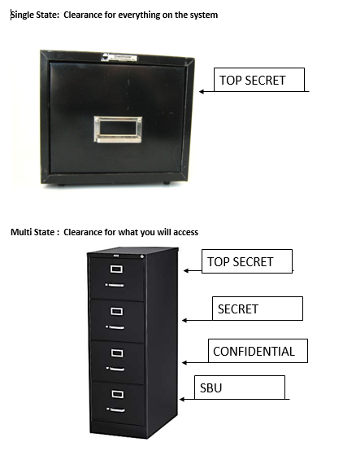
Multi-state
Single State

Slide 39
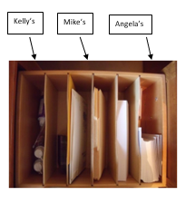

Compartmented
Dedicated

Slide 40
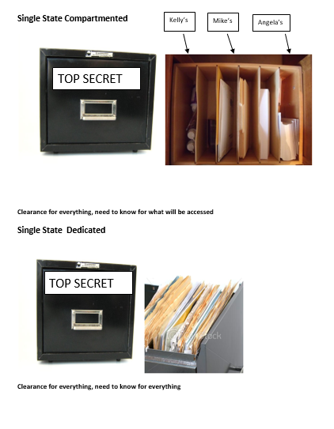
Single State Compartmented
Single State Dedicated

Slide 41
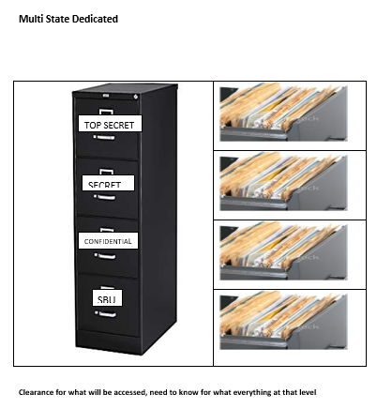
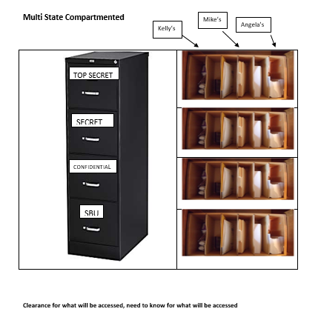
Multi-State, Comparted
Multi-State, Dedicated

Slide 42
Certification and Accreditation

Slide 43
Evaluation Criteria
Why Evaluate?
To carefully examine the security-related components of a system
Trust vs. Assurance
CMMI
The Orange Book (TCSEC)
The Orange Book & the Rainbow Series
ITSEC (Information Technology Security Evaluation Criteria)
Common Criteria

Slide 44
Trusted Computer Security Evaluation Criteria (TCSEC)
Developed by the National Computer Security Center (NCSC)
Also known as the Orange Book
Based on the Bell-LaPadulla model (deals with only confidentiality)
Uses a hierarchically ordered series of evaluation classes
Defines Trust and Assurance, but does not allow for them to be evaluated independently

Slide 45
TCSEC Evaluation
Trusted Computer Security Evaluation Criteria (TCSEC) aka “The Orange Book”
Ratings:
A1 – Verified Protection
B1, B2, B3 – Mandatory Protection
C1, C2 – Discretionary Protection
D – Minimal Security

Slide 46
IT Security Evaluation Criteria (ITSEC)
Created by a collection of European nations in 1991 as a standard to evaluate security attributes of computer systems
The First Criteria to evaluate functionality and assurance separately
F1 toF10 rates for functionality
E0 to E6 for assurance

Slide 47
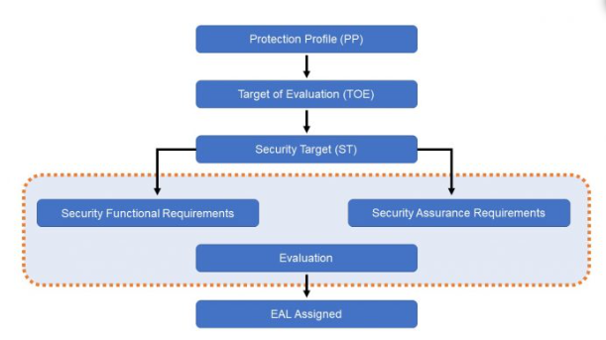
Common Criteria ISO 15408
Protection Profile: Requirements from Agency or Customer
Target of evaluation: System Designed by Vendor
Security target Documentation describing how ToE meets Protection Profile
Evaluation Assurance Level (EAL 1-7) Describes the level to which ToE meets Protection Profile

Slide 48
Common Criteria EAL Ratings
EAL 1 – Functionally tested
EAL 2 – Structurally tested
EAL 3 – Methodically tested and checked
EAL 4 – Methodically designed, tested, and reviewed
EAL 5 – Semi formally designed and tested
EAL 6 – Semi-formally verified designed and tested
EAL 7 – Formally verified designed and tested

Slide 49
Certification & Accreditation
Certification:
A process that ensures systems and major applications adhere to formal and established security requirements that are well documented and authorized.
It is usually performed by a vendor.
Accreditation:
A formal declaration by a Designated Accrediting Authority (DAA) that information systems are approved to operate at an acceptable level of risk based on the implementation of an approved set of technical, managerial, and procedural safeguards.

Slide 50
Domain 3 Part 2: Security Architecture and Design Review
Security Models
System Architecture
The Trusted Computing Base
Hardware Architecture
Software: Operating System Architecture
Software: Application Architecture
Secure Modes of Operation
Certification and Accreditation

Slide 51
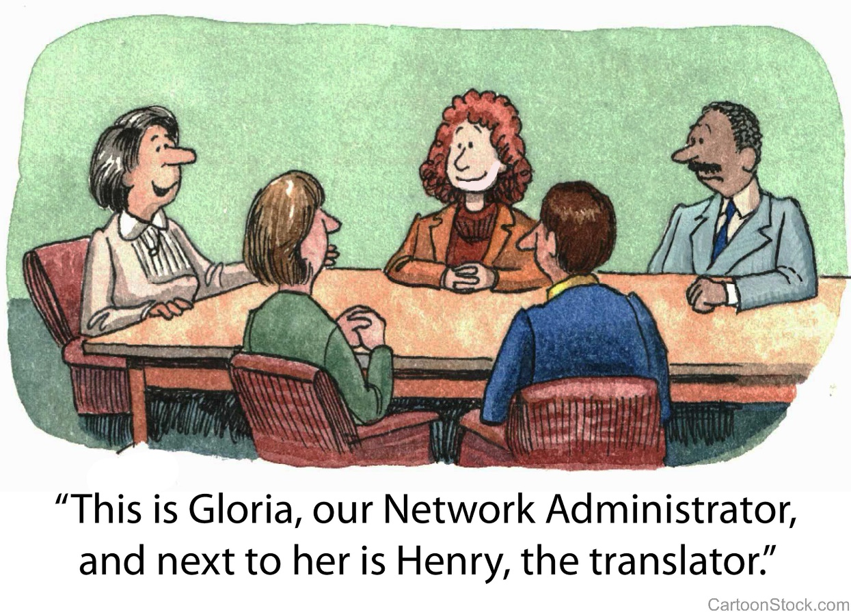
Domain 4
Communications and Network Security

Slide 52
Communications and Network Security Agenda
OSI Reference Model
Physical
Data Link
Network
Transport
Session
Presentation
Application
TCP/IP Model and OSI Review
Security Zones and Firewalls
Remote Access Protocols
Tunneling
Wireless Networking

Slide 53
The OSI Reference Model

Slide 54
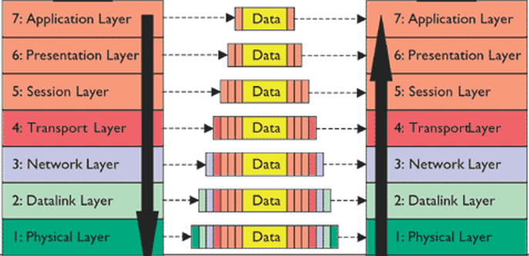
What is the OSI Model and Why Do We Need It?
Promotes interoperability between vendors
Enables standardization
Describes the encapsulation (Packaging) of data to enable it to get from point A to point B

Slide 55
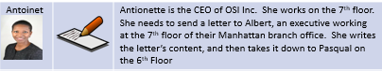

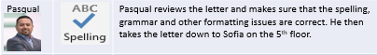

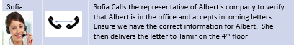
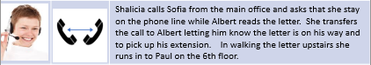
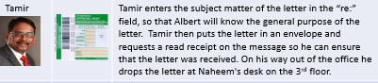
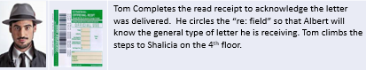
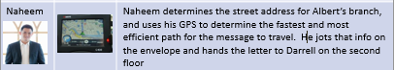






Slide 56
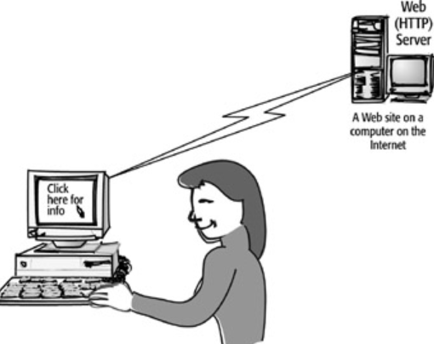
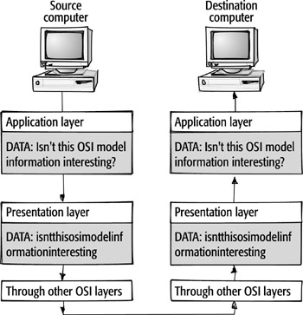
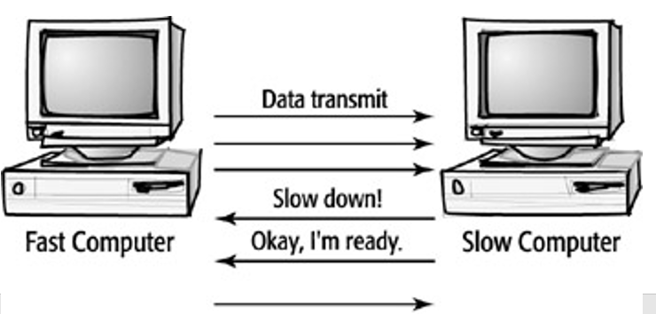
7. Application Layer
6. Presentation Layer
5. Session Layer

Slide 57
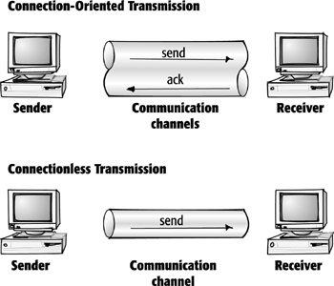
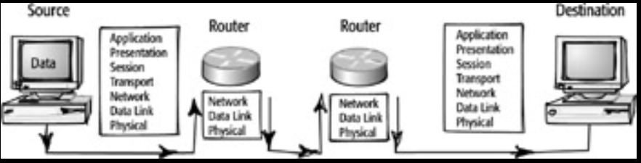
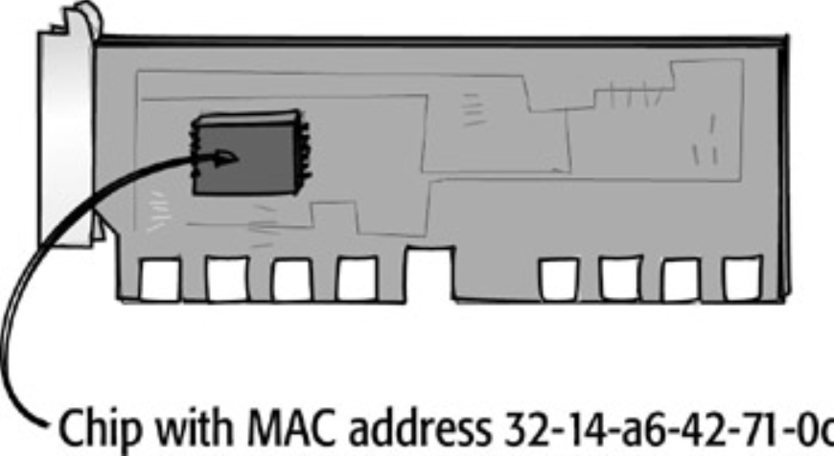

4. Transport Layer
3. Network Layer
2. Data Link Layer

Slide 58
Physical Layer

Slide 59
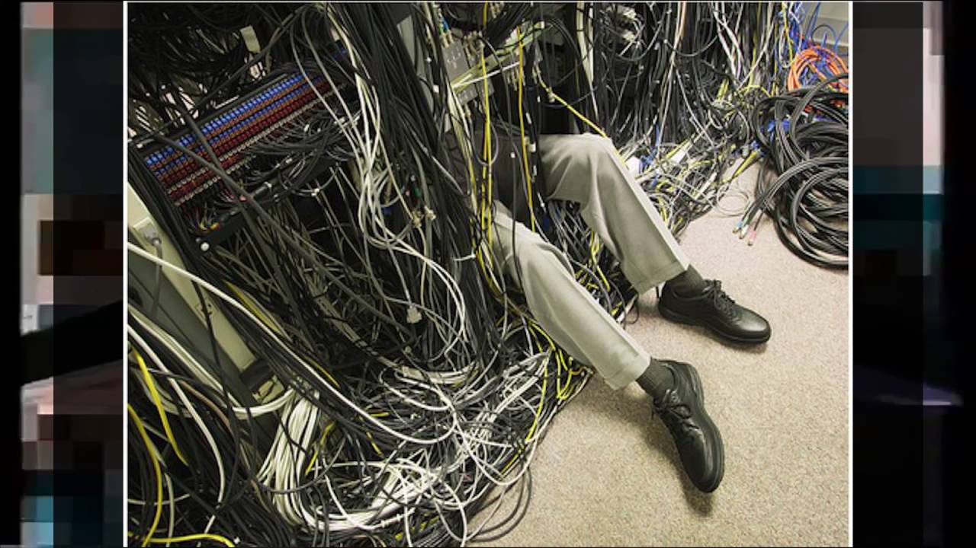
1. Physical Layer

Slide 60
Data and the OSI
Layer | OSI Layer | Functions/Mechanisms
7 | Application | Protocols that support the applications for users. HTTP, HTTPS, SMTP, POP3 Telnet, FTP, TFTP, NTP, NNTP, SNMP, and others
6 | Presentation | Formatting of message and multimedia formatting. GIF, JPEG, MP4, etc.
5 | Session | Headers are added to data for application-to-application communication (client-server.) RPC, SQL, LDAP Identification of communication streams
4 | Transport | Headers are added for acknowledgements and flow control. Port numbers added.. Data has now become a segment. TCP, UDP, SSL, TLS
3 | Network | Logical addressing and best path determination information is added to a segment, which now has become a packet. IP, ICMP, IPSec, IGRP Routers
2 | Data Link | Packet is delivered to layer 2 where MAC Addressing, Media Access Determination, Framing information are added. The packet is now a frame. ARP, RARP, Ethernet, Token Passing. Switches
1 | Physical Layer | Data placed on media. Wiring standards and protocols. Cable types, hubs. Frames are now converted to signal to traverse the physical media.
Layer | OSI Layer | Functions/Mechanisms
7 | Application | Reads the application layer protocol commands (such as, http) and display accordingly thru the user application
6 | Presentation | Interprets and formats the information correctly
5 | Session | Appropriate service is used to access data (based on port numbers) Then session information is used to id the appropriate data stream
4 | Transport | Segments assembled, acknowledgements sent. Port number is used to determine which service is needed. The data is passed upwards to layer 5
3 | Network | Removes the IP header of the Packet and passes the data on so that Transport layer information can be accessed by Layer 4. Data becomes a Segment after Network layer information is removed
2 | Data Link | Data Link headers including MAC addresses, etc are removed and the frame is converted to a packet
1 | Physical Layer | Physical signal is received and translated into bits. Bits are translated into frames and sent to Data Link Layer

Slide 61
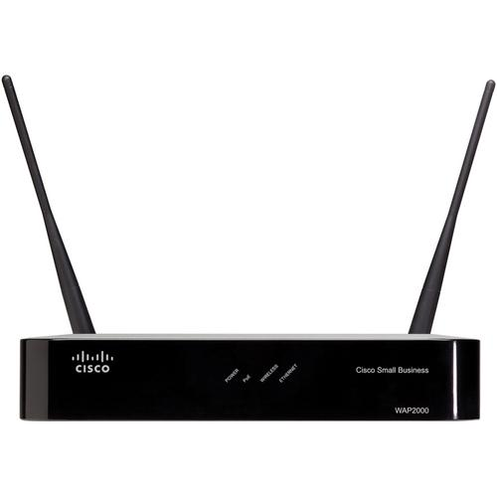
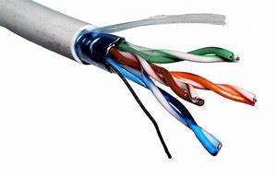
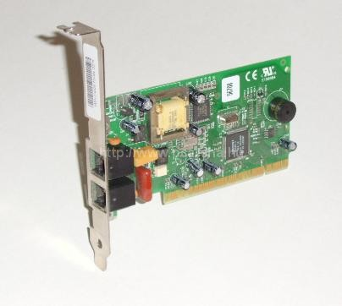
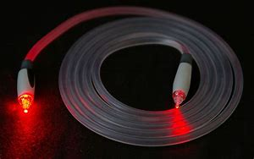
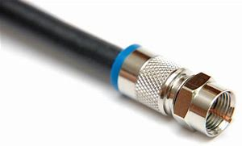

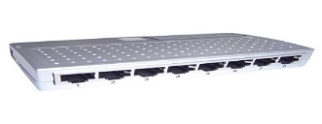
OSI Model – Layer 1 Physical
Layer 1 Physical – simply put is concerned with physical connectivity and sending electric signals over a medium.
All hardware devices have a point of connection, therefore at least partially have a layer 1 element
HUB

Slide 62
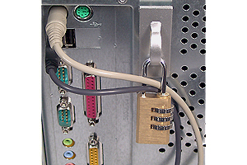
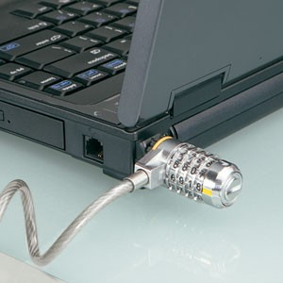
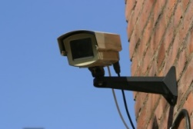
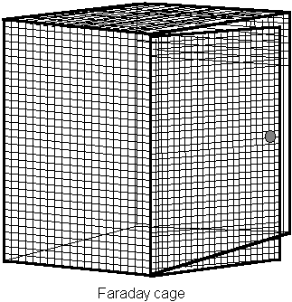
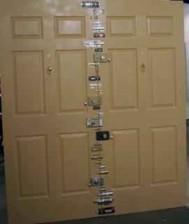

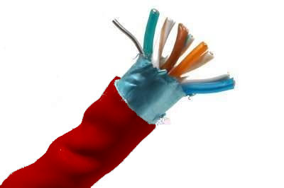
Layer 1 (Physical) Threats
Threats:
Theft
Unauthorized Access
Vandalism
Sniffing
Interference
Data Emanation

Slide 63
Data Link Layer

Slide 64
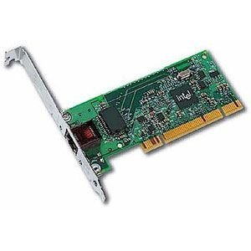
OSI model – Layer 2 Data Link
Data Link Layer
Only Layer of the OSI Model with 2 Sub-layers
LLC Logical Link Control—error detection
MAC Media Access Control—Physical
CSMA/CD Carrier Sense Multiple Access with Collision Detection (IEEE standard) 802.3 Ethernet
CSMA/CA Carrier Sense Multiple Access with Collision Avoidance(IEEE standard) 802.11 Wireless
Token Passing: 24 bit control frame passed around the network environment with the purpose of determining which system can transmit data. There is only one token and since a system can’t communicate without the token, there are no collisions.

Slide 65

Ethernet
Carrier Sense Multiple Access with Collision Avoidance
Used by ethernet
Contention (or collision based)
Multiple systems can access the network, but data will collide
Collisions slow things down!
Ethernet requires the resolution of an IP address to a MAC address

Slide 66
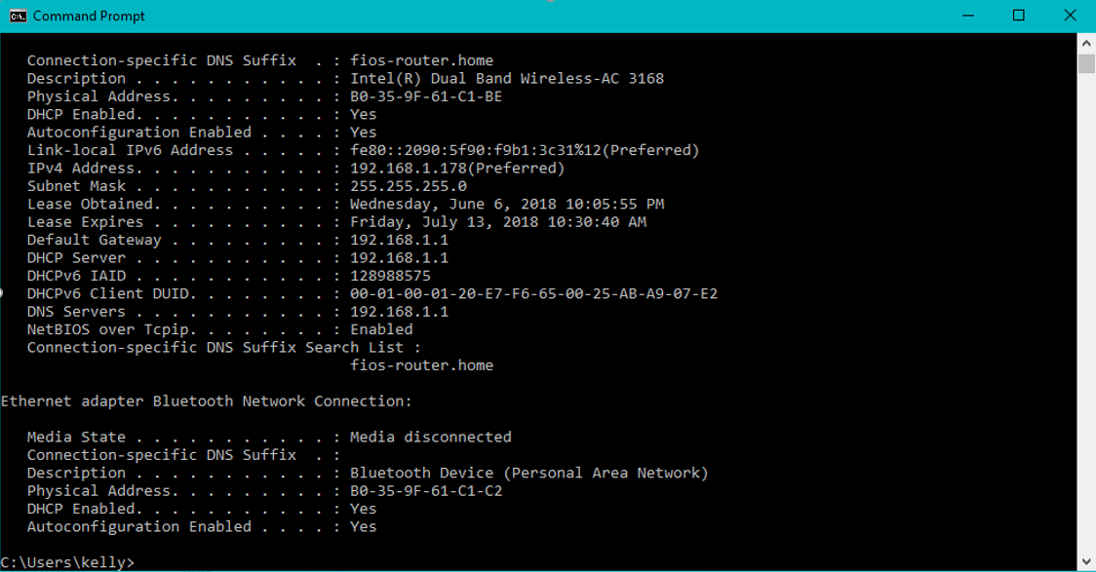
MAC Addresses
Notes:
A MAC address is a 48 bit hexadecimal address used to identify each network interface uniquely on the network. Every network card should have a unique MAC address assigned at the manufacturer. The first 24 bits identify the manufacturer and the last 24 bits identify the individual NIC. Though this address does not contain enough information to locate the interface anywhere in the world, once traffic has been resolved to the local network, the MAC is then used to find the interface. ARP (Address Resolution Protocol) is the protocol used to broadcast an IP address to learn the corresponding MAC. ARP cache is used to store MAC addresses already learned. ARP Poisoning is the modification of that cache, usually for malicious redirection.

Slide 67
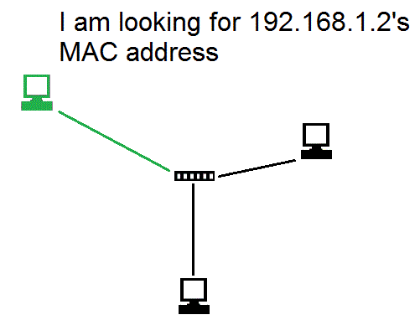
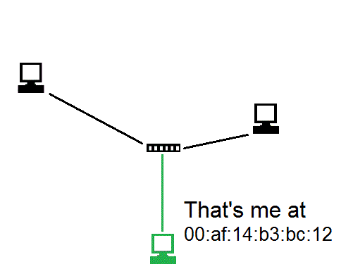
ARP
Notes:
ARP poisoning is manipulating a system’s ARP cache, usually for the purpose of redirection to a rogue device. Block unsolicited replies as a way of limiting the risk associated with cache poisoning—this could also be called cache pollution and can happen with webservers, DNS servers and any application that uses cache

Slide 68
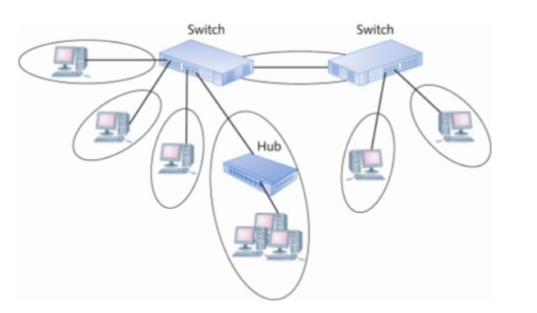
Switch
By default, switches operate at layer 2
Uses MAC addresses to direct traffic
Isolates traffic into collision domains
Does NOT isolate broadcasts natively
Notes:
Never underestimate the important of physical security for network devices. If possible restrict remote access and only allow administrative access through the local console. This method will force an intruder to go through a layer of physical security. If remote access must be allowed, use SSH (encrypted) instead of telnet (unencrypted).
MAC flooding will overwhelm a switch’s CAM table where learned MAC addresses are stored. If the CAM table does not a have an address, the switch sends a broadcast out all ports, just like a hub. This means an attacker can listen (sniff) for that traffic on any port.

Slide 69
Network Layer

Slide 70
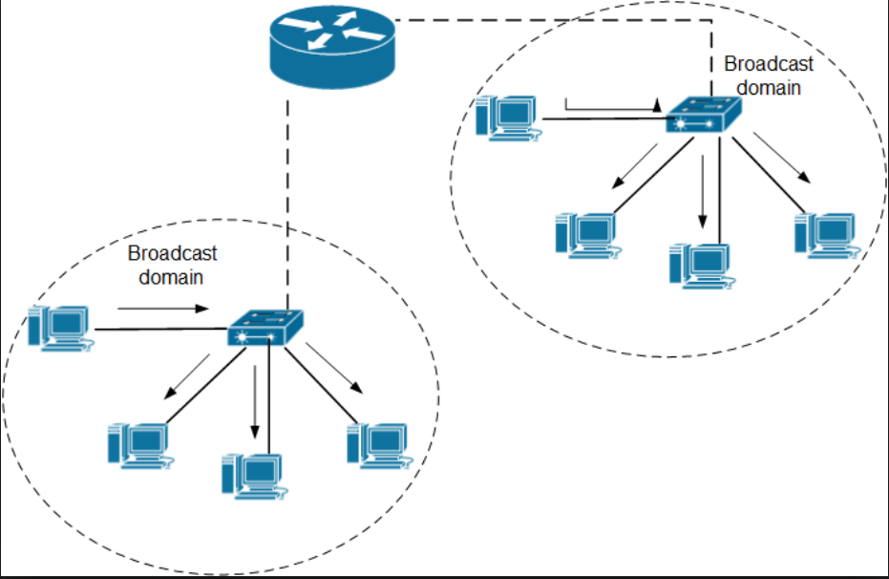
OSI model layer 3 network
Routers Isolate traffic into broadcast domains and use IP addressing to direct traffic
Notes:
o secure routers, use access controls lists (ACLs) to limit permitted traffic. Also implement physical security. IP Forwarding should be turned off of devices with multiple interfaces that are NOT acting as routers. Restrict the interfaces on which routers “learn” routes

Slide 71
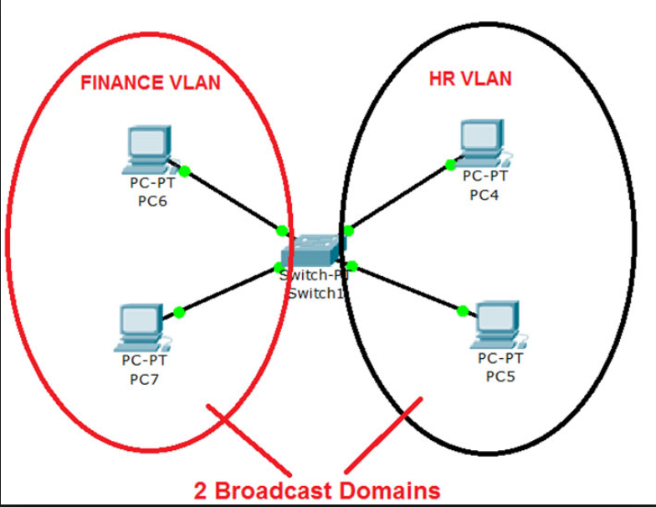
VLANs
Routers are expensive
To get broadcast isolation on a switch, a VLAN is necessary
Not all switches support VLANs
A Layer 2 switch (even with a VLAN) doesn’t truly understand Layer 3 IP Addressing
A Layer 3 switch is necessary for inter-Vlan Communication

Slide 72
Layer 3 Protocols
All Protocols that start with the letter “I” except IMAP (which is a layer 7 mail protocol)
IP
ICMP – IP “helpers” (like ping)
IGMP – Internet Group Message Protocol
IGRP
IPSEC
IKE
ISAKMP

Slide 73





ICMP
Ping Flood: Sends an overwhelming amount of ICMP echo request packets
SMURF: Uses a spoofed source address (Target) and directed broadcasts to launch a DDos

Slide 74
Transport Layer

Slide 75
OSI model Layer 4 Transport
OSI Layer 4 Transport – Provides end-to-end data transport services and establishes a logical connection between 2 computers systems”
The “pony express”
Protocols used at layer 4
SSL/TLS (Discussed in Cryptography Domain)
TCP
UDP

Slide 76
TCP (Transmission Control Protocol)
Connection oriented “guaranteed” delivery.
Advantages
Easier to program with
Truly implements a session
Adds security
Disadvantages
More overhead / slower
SYN Floods

Slide 77

TCP
A reliable, connection-oriented protocol, which uses the three way handshake as seen below

Slide 78
UDP (User Datagram Protocol)
Connectionless
Unreliable
No handshaking
Desirable when “real time” transfer is essential
Media Streaming, Gaming, live time chat, etc
FTP uses TCP
TFTP uses UDP

Slide 79

Best Joke Ever…..
What’s the best thing about a UDP Joke???
I don’t care if you get it or not!

Slide 80
Session Layer

Slide 81

OSI Model Layer 5 Session
OSI Layer 5 (Session) – responsible for establishing a connection between two applications (either on the same computer or two different computers)
Dialogue control
Release connection

Slide 82
Presentation Layer

Slide 83
OSI model Layer 6 Presentation
Present the data in a format that all computers can understand
This is the only layer of OSI that does NOT have any protocols.
Concerned with encryption, compression and formatting
Making sure data is presented in a universal format
File level encryption
Removing redundancy from files (compression)

Slide 84
Application Layer

Slide 85
OSI model Layer 7 – Application
This defines a protocol (way of sending data) that two different programs or applications understand.
HTTP, HTTPS, FTP, TFTP, SMTP, SNMP, etc.
Application Proxies
Non-Repudiation
Certificates
Integration with Directory Services
Time awareness---NTP Network Time Protocol—Controls synchronization of time on systems---Kerberos, digital forensics, and many other services require time synchronization.

Slide 86
I was going to tell you an NTP joke but…
My timing is always off

Slide 87
TCP Model and OSI Review

Slide 88

OSI vs. TCP/IP model

Slide 89

OSI/TCP…What you need to know

Slide 90
Security Zones and Firewalls

Slide 91
Security Zones
It is common practice in network and physical security to group different security levels into different areas or zones. Each zone is either more or less trusted then the other zones. Interfaces between zones have some type of access control to restrict movement between zones (like biometric and guard stations) or firewalls.) In Network security there is often a median zone between the Internet and internal network called a DMZ.

Slide 92

DMZ
A buffer zone between an unprotected network and a protected network that allows for the monitoring and regulation of traffic between the two.
Internet accessible servers (bastion hosts) are placed in a DMZ between the Internet and Internal network
Untrusted
Semi-Trusted
Trusted

Slide 93

Firewalls
Designed to provide filtering between Trust Zones
Software or Hardware Based
Provide isolation and separation
Create zones based on trust
Used Rule-based access control

Slide 94
Firewalls and the OSI Model
Layer 3 (Network Layer)
Packet Filtering
Screening Routers
Inspect Layer 3 & Layer 4 Headers
Source and Destination IP
Source and Destination Port
Protocol (TCP or UDP)

Slide 95
Firewalls and the OSI Model
Layer 5 (Session Layer)
Stateful Filtering
Awareness of the initiation of the session and the state
Can block unsolicited replies
Can understand syntax of lower layer protocols and can block “misbehaving” traffic

Slide 96
Firewalls and the OSI Model
Layer 7 (Application Layer)
Called Application Proxies/Firewalls
Deep Packet Inspection
Forward Proxy inspects traffic from inside going out
Reverse Proxy inspects traffic from outside going in
Can inspect on content, time, application-awareness, certificates, etc.
Specific to the application protocol

Slide 97

NAT/PAT

Slide 98
NAT / PAT
Advantages
Allows you to use private addresses Internally, you don’t need to get real public IP addresses for each computer
Allows the use of RFC 1918 IP addresses
10.x.x.x
172.6.x.x-172.31.x.x
192.168.x.x
Hides internal network structure
Transparent, doesn’t require special software
Disadvantages
Single Point of Failure / Performance Bottleneck
Doesn’t protect from bad content

Slide 99
Overall Firewall best practices
Block un-necessary ICMP packets types.
(Be careful though, know your environment)
Keep ACLS simple
Use Implicit deny*
Block directed IP broadcasts
Perform ingress and egress filtering*
Block traffic leaving the network from a non-internal address (indicates the network is possibly being used as zombie systems ina possible DDoS attack.
Block all traffic entering the network from an internal address (indicates a potential spoofing attack)
Enable logging
Drop fragments or re-assemble fragments

Slide 100
WAN Technology

Slide 101
LAN, WAN
LAN – local area network
High speed
Small physical area
WAN – wide area network
Used to connect LANS
Generally slow, using serial links

Slide 102

Circuit Switching
PSTN
ISDN
DSL
T-carriers

Slide 103

Packet Switching
X.25
Frame Relay
ATM
IP Networks
VOIP
MPLS
Cable

Slide 104

MPLS (Multi Protocol Labeled Switching)
In an MPLS network, each packet gets labeled on entry into the service provider's network by the ingress router, also known as the label edge router (LER). This is also the router that decides the LSP the packet will take until it reaches its destination address.
All the subsequent label-switching routers (LSRs) perform packet forwarding based only on those MPLS labels -- they never look as far as the IP header. Finally, the egress router removes the labels and forwards the original IP packet toward its final destination.

Slide 105

VOIP Voice Over IP

Slide 106
VOIP Security Issues
Eavesdropping (greatest threat)—Enable S/RTP
Toll Fraud
Vishing
SPIT
Performance Issues
Latency
Jittering

Slide 107
Remote Access Protocols

Slide 108
Remote Access
Dial Up
PPP
PAP, CHAP EAP
Tunneling
PPTP
PAP, CHAP EAP
MPPE
GRE
L2TP
IPSEC
IPSEC
Wireless
Encryption
WEP, WPA, WPA II
Authentication
802.1x

Slide 109

Dial-up
PPP Point to Point Protocol: Provides Layer 2 framing for dial-up. Needs other protocols for security
Encryption: MPPE
Authentication:
PAP (Password Authentication Protocol): Clear Text
CHAP (Challenge Handshake Authentication Protocol) Client responds to a challenge from the server. The only way the client can answer correctly is if the correct password had been entered.
EAP (Extensible Authentication Protocol) Extends capabilities beyond passwords (smart cards, biometrics, token devices, etc)

Slide 110
Tunneling

Slide 111

Tunneling
A function of VPNs - Tunnel encapsulates one protocol within another creating a virtual network.
Can encrypt original IP headers
Can encrypts data
Allows for routing non routable protocols and IP addresses
Can provide remote/internal IP addresses

Slide 112
Tunneling protocols
Different protocols
PPTP
L2TP
IPSEC
GRE

Slide 113
PPTP
Point to Point Tunneling Protocol
Based on PPP (uses MPPE for encryption and PAP, CHAP or EAP for authentication)
Lead by Microsoft protocol for a tunneling VPN
Only works across IP networks
Remote user connects to ISP, gets an Internet Address
Establishes VPN connection to work VPN server, get’s Internal IP address.
Sends private IP packets encrypted within other IP packets.

Slide 114
L2TP
Layer 2 Tunneling Protocol
Cisco designed L2F to break free of dependence on IP networks, but kept it proprietary.
L2TP was a combination of L2F and PPTP
Designed to be implemented in software solutions
THERE IS NO SECURITY with L2TP. It MUST use IPSec to secure

Slide 115
Generic Routing Encapsulation (GRE)
Point to point link between two networks. It adds an extra IP header to the original packet. Much more frequently used in the past to encapsulate AppleTalk, IPX and other older protocols.
Data encapsulation – GRE tunnels encapsulate packets that allow protocols to traverse an incompatible network. For example, to route IPv4 packets across a network that only uses IPv6.
Simplicity – GRE tunnels lack mechanisms related to flow-control and security by default. This lack of features can ease the configuration process. However, you probably don’t want to transfer data in an unencrypted form across a public network; therefore, GRE tunnels can be supplemented by the IPSec suite of protocols for security purposes. In addition, GRE tunnels can forward data from non-contiguous networks through a single tunnel, which is something VPNs cannot do.
Multicast traffic forwarding – GRE tunnels can be used to forward multicast traffic, whereas a VPN cannot. Because of this, multicast traffic such as advertisements sent by routing protocols can be easily transferred between remote sites when using a GRE tunnel.

Slide 116
Wireless Networking

Slide 117

Wireless Networking
Mobility − A wireless communications system allows users to conduct business from anywhere without
Reachability − Wireless communication systems enable people to be stay connected and be reachable, regardless of their location.
Simplicity − Wireless communication system are easy and fast to deploy in comparison of cabled network. Caution: Ease of use is often the enemy of security!
Maintainability − In a wireless system, you do not have to spend too much cost and time to maintain the network setup.
Roaming Services − Using a wireless network system, you can provide service any where any time including train, buses, airplanes etc.
Additional Services − Wireless communication systems provide various smart services like SMS and MMS

Slide 118
Wireless security problems
Unauthorized access
sniffing
War driving
Unauthorized access points (Man in the middle)

Slide 119

Wireless Security
Encryption
WEP
Shared authentication passwords
Weak IV (24 bits)
IV transmitted in clear text
RC-4 (stream cipher)
Easily crackable
Only option for 802.11b
WPA
Stronger IV
Introduced TKIP
Still used RC-4
WPA2
AES
CCMP
NOT backwards compatible
Authentication
WPA and WPA2 Enterprise Uses 802.1X authentication to have individual passwords for individual users (RADIUS)

Slide 120

Bluetooth
Bluetooth is a Personal Area Network protocol designed to free devices from physical wires.
Bluetooth Modes
Discovery Mode
Automatic Pairing
Blue jacking
Sending SPAM to nearby bluetooth devices
Blue Snarfing
Copies information off of remote devices
Blue bugging
More serious
Allows full use of phone
Allows one to make calls
Can eavesdrop on calls

Slide 121
Communications and Network Security Review
OSI Reference Model
Physical
Data Link
Network
Transport
Session
Presentation
Application
TCP/IP Model and OSI Review
Security Zones and Firewalls
Remote Access Protocols
Tunneling
Wireless Networking

Slide 122

Domain 5
Identity and Access Management

Slide 123
Domain 5 Identity and Access Management Review
Overview
Identity Management
Identity Proofing
Account Provisioning/Deprovisioning
Authentication
Type 1, Type 2, Type 3
Kerberos and Single Sign on
Single Sign on: Federated Services
Authorization
Access Control Models
Enforcing Access Control
Access Control Management
Auditing/Accountability
Data Emanation

Slide 124

Identity and Access Management
Per ISC2, Identity and Access Management solutions “focus on harmonizing the provisioning of users and managing their access across multiple systems with different native access control systems”.
Identity Management
Controls the life cycle for all accounts in a system
Access Management
Controls the assignment of rights/privileges to those accounts

Slide 125
IAAA of Access Control
The components of Access Control that we are about to discuss are:
Identification:
Make a claim (userid etc)
Authentication:
Provide support (proof) for your claim
Authorization:
What rights and permissions you have
Auditing:
Accountability—matching actions to subjects

Slide 126
Identity Management

Slide 127

Identity Proofing
Proceeds the creation of a user account
Not the same as authentication
Requires the prospective employee to prove their identity to the employer.
Long before an employee is given a user account to identify with on the network, they have proven their identity to their employer

Slide 128
Account Provisioning
Account provisioning or identity provisioning technology creates, modifies, disables and deletes user accounts and their profiles across IT infrastructure and business applications.
Discretionary account provisioning: Administrators determine which applications and data a user should have access to
Self-Service account provisioning: users participate in some aspects of the provisioning process, thus reducing administrative overhead. Often, users are allowed to request an account and manage their passwords.
Workflow-based account provisioning - gathers the required approvals from the designated approvers before granting a user access to an application or data. For example, the business rules in a finance application might require that every new account request be approved by the company's Chief Financial Officer (CFO).
Automated account provisioning -- requires every account to be added the same way through an interface in a centralized managment application. This streamlines the process of adding and managing user credentials and provides administrators with the most accurate way to track who has access to specific applications and data sources.
Notes:
Types of user account provisioning include:
Discretionary account provisioning - allows a network administrator to decide for himself which applications and data the end user should be able to access. A discretionary approach is often used in small or mid-sized companies.
Self-service account provisioning - allows users to participate in some aspects of the provisioning process in order to reduce the administrator's overhead. Typically, users are able to request an account and manage their own passwords.
Workflow-based account provisioning - gathers the required approvals from the designated approvers before granting a user access to an application or data. For example, the business rules in a finance application might require that every new account request be approved by the company's Chief Financial Officer (CFO).
Automated account provisioning -- requires every account to be added the same way through an interface in a centralized managment application. This streamlines the process of adding and managing user credentials and provides administrators with the most accurate way to track who has access to specific applications and data sources.

Slide 129

Identity/Account Provisioning

Slide 130
Identity Management: Provisioning/Deprovisioning
Traditionally, different cloud vendors used non-standard provisioning APIs
Enterprises to develop and maintain proprietary connectors to integrate with multiple SaaS providers
Alternatively, Provisioning can be managed easier through
Service Provisioning Markup Language (SPML)
Older, seldom implemented due to the inflexibility and lack of vendor support
System for Cross-domain Identity Management…or…Simple Cloud Identity Management (SCIM)
Defines a Schema and an API for managing identities
System for Cross-domain Identity Management (SCIM) is an open standard for automating the exchange of user identity information between identity domains, or IT systems.

Slide 131

Traditional Identity Management in the Cloud

Slide 132


Proprietary APIs, SPML and SCIM
SPML

Slide 133
System Identification
Once an account has been provisioned, the first step a user undertakes to access a system is to provide identification
Public Information (usually we aren’t concerned with protecting identities)
Identification must be unique for accountability
Standard naming schemes should be used
Identifier should not indicate extra information about user (like job position)
User ID
Account Number
RFID
IP or MAC address
Unless Authentication is used, identities are easily spoofed

Slide 134
Authentication

Slide 135

Authentication
Proving a claimed identity
Type 1: Something you know
Type 2: Something you have
Type 3: Something you are
The Strongest authentication is multi-factor---a combination of the above
Mutual Authentication is desirable as well

Slide 136
Type 1: Something You Know

Slide 137

Type 1: Something You Know
Passwords/Passphrases/Cognitive Password
Best practices
No less than 8 characters
Change on a regular basis
Enforce password history
Consider brute force and dictionary attacks
Ease of cracking cognitive passwords
Graphic Image
Enable clipping levels and respond accordingly

Slide 138
Type 2: Something You Have

Slide 139
Type 2: Something you have
Token Devices
Smart Card
Memory Card
Hardware Key
Cryptographic Key
Certificate
Cookies

Slide 140
Token Devices: One Time Password Generators
Password that is used only once then no longer valid
One time password reduces vulnerability associated with sniffing passwords.
Simple device to implement
Can be costly
Users can lose or damage
Two Types: Synchronous/Asynchronous

Slide 141


Token Devices
Synchronous Token Devices
Rely upon synchronizing with authentication server. Frequently time based, but could be event based
If damaged, or battery fails, must be re-synchronized
Authentication server knows what “password” to expect based on time or event.
Asynchronous/ Challenge Response
User logs in
Authentication returns a challenge to the user
User types challenge string into token device and presses enter.
Token device returns a reply
Only that specific user’s token device could respond with the expected reply.
More Complex than synchronous
May provide better protection against sniffing

Slide 142

Memory Cards

Slide 143


Memory Cards
Holds information, does NOT process
A memory card holds authentication info, usually you’ll want to pair this with a PIN… WHY?
A credit card or ATM card is a type of memory card, so is a key/swipe card
Usually insecure, easily copied.*

Slide 144



Smart Card
EMV CHIP
EMV chip technology is becoming the global standard for credit card and debit card payments. Named after its original developers (Europay, MasterCard® and Visa®), this technology features payment instruments (cards, mobile phones, etc.) with embedded microprocessor chips that store and protect cardholder data.

Slide 145
Type 3: Something You Are/Do

Slide 146
Type 3: Something You Are
Biometrics
Physiological (Static): Should not significantly change over time. Bound to a user’s physiological traits
Fingerprint, hand geometry, iris, retina, etc
Behavior-based (Dynamic): Based on behavioral traits
Voice, gait, signature, keyboard cadence, etc
Even though these can be modified temporarily, they are very difficult to modify for any significant length of time.

Slide 147

Crossover Error Rate
Accuracy
Type I Error: False Rejection--A legitimate user is barred from access. Is caused when a system identifies too much information. This causes excessive overhead.
Type II Error: False Acceptance—An impostor is allowed access. This is a security threat and comes when a system doesn’t evaluate enough information
As FRR goes down, FAR goes up and vice versa
The level at which the two meet is called CER (Crossover Error Rate). The lower the number, the more accurate the system
Iris Scans are the most accurate

Slide 148
Biometric Concerns
User Acceptance
Many users feel biometrics are intrusive
Retina scans can reveal health care information
Time for enrollment and verification can make user’s resistant
Cost/benefit analysis
No way to revoke biometrics

Slide 149
Kerberos and Single Sign On (SSO)

Slide 150
Single Sign On
Allows a user to provide credentials to an authentication server and receive accessed to interconnected and disparate systems.
Pros
Ease of use for end users
Centralized Control
Ease of administration
Cons
Single point of failure
Standards necessary
Keys to the kingdom
Kerberos
LDAP
Sesame
Krypto-Knight

Slide 151
Kerberos
A network authentication protocol designed from MITs project Athena. Kerberos tries to ensure authentication security in an insecure environment
Used in Windows2000+ and some Unix
Allows for single sign on
Never transfers passwords
Uses Symmetric encryption to verify Identifications
Avoids replay attacks

Slide 152
Kerberos Components
Essential Components:
AS (Authentication Server): Allows authentication of the user and issues a TGT
TGS: After receiving the TGT from the user, the TGS issues a ticket for a particular user to access a particular service KDC (Key Distribution Center) a system which runs the TGS (Ticket Granting Service) and the AS (Authentication Service)
Ticket: Means of distributing Session Key
Principles (users, applications, services)
Kerberos Software (integrated into most Operating Systems. MS Windows 2000 and up support Kerberos)
Main Goal: User needs to authenticate himself/herself without sending passwords across the network—needs to prove he/she knows the password without actually sending it across the wire.

Slide 153

The Carnival

Slide 154

The Kerberos Carnival

Slide 155
Kerberos Concerns
Computers must have clocks synchronized within 5 minutes of each other
Tickets are stored on the workstation. If the workstation is compromised your identity can be forged.
If your KDC is hacked, security is lost
A single KDC is a single point of failure and performance bottleneck
Still vulnerable to password guessing attacks

Slide 156
Single Sign On Federated Services

Slide 157

Today’s Identity Management in the Cloud
Provisioning Identities
Authentication
Authorization
As a company on-boards and off-boards employees, they are added and removed from the company's electronic employee directory. As long as the service provider supports the SCIM standard, SCIM Could then be used to automatically add/delete (or, provision/de-provision) accounts for those users in external systems such as Google Apps for Work, Office 365, or Salesforce.com. Then, a new user account would exist in the external systems for each new employee, and the user accounts for former employees would be removed from those systems

Slide 158
SAML (Security Assertion Markup Language)
For SSO with web applications, SAML works using set of browser redirects and message exchanges.
User tries to access web application, the application redirects user to identity provider.
User authenticates himself
Identity provider issues a claims token and redirects user back to the application.
Application then validates the token (trust needs to established out of band between application and IdP), authorizes user access by asserting claims, and allows user to access protected resources.
The token is then stored in the session cookie of user browser, ensuring the process doesn’t have be repeated for every access request

Slide 159

SAML Assertions
Student Registers at School
Student goes to library to receive his books
Library directs student to the student center to pick up his Student ID badge
Student Center has access to the same database as the university, so they verify the identity of the student and give him his student id badge
Student Provides the library his Student ID Number and badge and requests his books.
Library accepts the school ID as proof of authenticity and provides student his books

Slide 160


Slide 161


Slide 162
Authorization: OAUTH 2.0
OAuth (Open Standard for Authorization) has different intent
Not designed for SSO
Provides delegation of rights to applications
In simplest terms, it means giving your access to someone you trust, so that they can perform the job on your behalf. E.g. updating status across Facebook, Twitter, Instagram, etc. with a single click.
Could go to the sites manually, but easier to delegate access to an app that connect the above platforms
Authenticate yourself to Facebook, Facebook provides a consent page stating you are about give this app rights to update status on your behalf. If you agree, the app gets an opaque access token from Facebook, app stores that access token, send the status update with access token to Facebook
Facebook validates the access token (easy in this case as the token was issued by Facebook itself), and updates your status.

Slide 163
Authorization

Slide 164
Authorization
Now that I proved I am who I say I am, what can I do?
Both Operating Systems and Applications can provide this functionality.
Authorization can be provided based on user, groups, roles, rules, physical location, time of day (temporal isolation)* or transaction type (example a teller may be able to withdrawal small amounts, but require manager for large withdrawals)

Slide 165
Authorization principals
Default NO access (implicit deny)* - Unless a subject is explicitly given access to an object, then they are implicitly denied access.
Principle of Least Privelege
Need to know
Content-based

Slide 166
Access Control Models

Slide 167
Access Control Models
A framework that dictates how subjects access objects.
Uses access control technologies and security mechanisms to enforce the rules
Supported by Access Control Technologies
Business goals and culture of the organization will prescribe which model is used
Every OS has a security kernel/reference monitor (talk about in another Domain) that enforces the access control model.

Slide 168
Access Control Models
The models we are about to discuss are
From the TCSEC(Trusted Computer System Evaluation Criteria—Orange Book)
DAC (Discretionnary Access Control)
MAC (Mandatory Access Control)
Other Models
RBAC (Role Based Access Control)
ABAC (Attribute Based Access Control)
RuBAC (Rule Based Access Control)

Slide 169
DAC
Discretionary Access Control
Security of an object is at the owner’s discretion
Access is granted through anACL (Access Control List)
Commonly implemented in commercial products and all client based systems
Identity Based

Slide 170
MAC
MAC is used where classification and confidentiality is of utmost importance… military.
Generally you have to buy a specific MAC system, DAC systems don’t do MAC
SELinux
Trusted Solaris (now called Solaris with Trusted Extensions)
All objects in a MAC system have a security label*
Security labels can be defined the organization.
They also have categories to support “need to know” at a certain level.
Categories can be defined by the organization

Slide 171

Role Based Access Control
RBAC is a good solution to mitigate privilege creep and provides the strongest constraint on user access
RBAC is well-suited for environments with high turnover rates

Slide 172

Attribute Based Access Control
Permissions or privilege granted based on attributes of the subject. Attributes can be
Location
Role
Tenure
Any other attribute of the subject or object

Slide 173
Enforcing Access Control

Slide 174
Enforcing Access Control
We will talk more in depth of each in the next few slides.
Constrained User Interfaces
Access Control Matrix
Access Control Lists
Content-Dependant Access Control
Context-Dependant Access Control

Slide 175
Constrained User Interfaces
Restrict user access by not allowing them see certain data or have certain functionality (see slides)
Views – only allow access to certain data (canned interfaces)
Restricted shell – like a real shell but only with certain commands. (like Cisco's non-enable mode)
Menu – similar but more “GUI”
Physically constrained interface – show only certain keys on a keypad/touch screen. – like an ATM. (a modern type of menu) Difference is you are physically constrained from accessing them.

Slide 176

Physically Constrained Interface

Slide 177


Content vs. Context Dependant Access Control
Content: WHAT is accessed? Focus is on the asset
Context: How and Why is it being accessed? The asset isn’t the driver for decisions but things like time, location, type of connection, etc

Slide 178


Rule-Based Access Control
Rule-based access control is based on rules to deny or allow access to resource
If the rule is matched, access will be denied or allowed, based on the rule
Routers, Firewalls, Proxies and other filtering devices use rules to enforce access
Sometimes called “Non-Discretionary” because the rules cannot be arbitrarily bypassed

Slide 179
Access Control Management

Slide 180
Centralization vs. Decentralization
Centralization:
Greater Consistency
Ease of Administration
Greater Control
Usually considered more secure
Decentralization
Granularity
Flexibility

Slide 181
Centralized Access Control Administration
A centralized place for configuring and managing access control
All the ones we will talk about (next) are “AAA” protocols
Authentication
Authorization
Auditing
Radius
TACACS, TACACS+
Diameter

Slide 182

Centralized Authentication for Remote Clients: 802.1x
802.1X is a security feature that provides a means to authenticate devices before they can access network resources.

Slide 183

RADIUS, DIAMETER, TACACS
RADIUS
Designed for dial-up, but extensions are available to allow additional functionality as needed
RADIUS encrypts only the password in the access-request packet, from the client to the server.
RADIUS uses UDP
TACACS+
Provides same services
Developed by Cisco
Separates roles of AAA
USES TCP
DIAMETER
DIAMETER is a protocol designed as the next generation RADIUS
RADIUS is limited to authenticating users via SLIP and
PPP dial-up modem connections

Slide 184
TACACS+
Provides the same functionality of Radius
TACACS+ can support one time passwords
Encrypts ALL traffic data
TACACS+ separates each AAA function.
For example can use an AD for authentication, and an SQL server for accounting.
Uses TCP

Slide 185
Diameter
Supposed to be the next generation of RADIUS (Diameter is TWICE the RADIUS)
Includes better message transport, proxying, session control, and higher security for AAA transactions
Provides encryption for the communication, not just the password
Never gained the application support RADIUS did
USES UDP

Slide 186
Auditing

Slide 187

Audits
Associate Audits with compliance:
Compliance with policy
Compliance with Standards
Remember Auditors do not need write protection
Also, auditors do not provide suggestions on remediation

Slide 188
Data Emanation Security

Slide 189

Emanation Security
All electronic devices emit radiation. TEMPEST was a study t o determine if anything meaningful could be learned. YES!
Tempest then became a standard to develop countermeasures to protect against this.
Faraday cage – a metal mesh cage around an object, it negates a lot of electrical/magnetic fields.
White Noise – a device that emits radio frequencies designed to disguise meaningful transmission.
Control Zones – protect sensitive devices in special areas with special walls etc.

Slide 190
Domain 5 Identity and Access Management Review
Overview
Identity Management
Identity Proofing
Account Provisioning/Deprovisioning
Authentication
Type 1, Type 2, Type 3
Kerberos and Single Sign on
Single Sign on: Federated Services
Authorization
Access Control Models
Enforcing Access Control
Access Control Management
Auditing/Accountability
Data Emanation

